Slide 1
TaskAssemble
A Project Management tool

Slide 2
Choosing the Use Case
Objective: Design UI of a lightweight project management tool for small projects. Enable task creation, assignment, and tracking.
Introduction: In the contemporary business landscape, effective project management is a linchpin for success.
Challenges: Conventional project management tools often grapple with fragmented collaboration, delayed updates and complex interfaces.
Needs Addressed: Our project management tool aims to counter these challenges by providing a holistic solution, fostering team collaboration, enabling real-time progress tracking, and ensuring timely and budget-compliant project deliveries.

Slide 3
Research Done
Exhaustive research was undertaken to comprehend prevailing project management methodologies and tools.
Valuable insights were gleaned from leading articles, comprehensive, and instructive videos like
The research served as a compass, guiding our decisions and ensuring that our project management tool not only incorporates industry best practices but also addresses current pain points.
Few Links:Top Project Management Tools- Article by TheHindu
Analysis by Forbes
Different platforms working
Figma tutorials

Slide 4
Prototype
Our project management tool encompasses the features like:
Project creation and management.
Task creation with due dates and priority levels.
Task assignment to team members with status tracking.
Chat with the whole team assigned or to an individual member.
The interface is thoughtfully designed for user-friendliness, empowering team members to navigate effortlessly and manage their projects seamlessly.

Slide 5
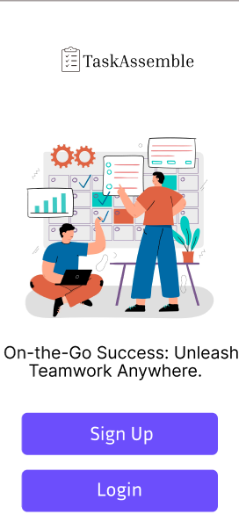
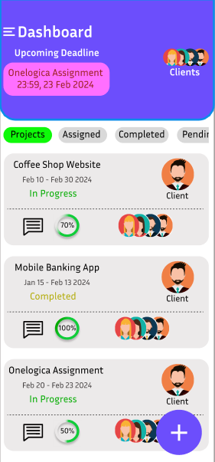
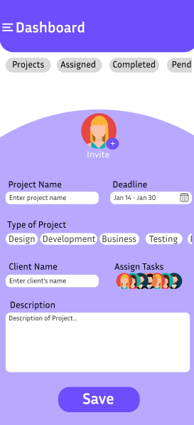
Screenshots of Interface

Slide 6
Benefits
Enhanced Collaboration: Our tool cultivates real-time collaboration, transcending geographical barriers and fostering a seamless work environment.
Increased Efficiency: Automated task tracking and reporting features augment project efficiency, ensuring streamlined processes.
Positive Outcomes: Users can anticipate enhanced project outcomes, elevated stakeholder satisfaction, and a more efficient and organized project management workflow.

Slide 7
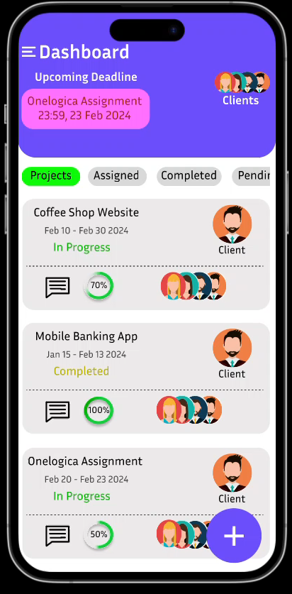
Video of the Interface

Slide 8
GitHub and Other resources
https://github.com/Sakshiii-Singhhh/OneLogica-Assignment.git
https://www.freepik.com/
https://www.figma.com/
https://dribbble.com/
https://in.pinterest.com/
https://www.canva.com/

